Slide 1
Medical Device Companies

Slide 2
Table of Contents
01
04
02
05
03
06
Dataset Description
Model Training and Testing
Exploration
Comparison between models
Preprocessing & Visualization
Forecasting

Slide 3
01
Dataset Description

Slide 4
Medical Device Companies Revenue Data
The dataset comprises quarterly revenue data for various medical device companies over a period of time. This data is essential for understanding the financial performance and trends of these companies, which can be crucial for forecasting future revenues and making informed business decisions.

Slide 5
02
Exploration

Slide 6
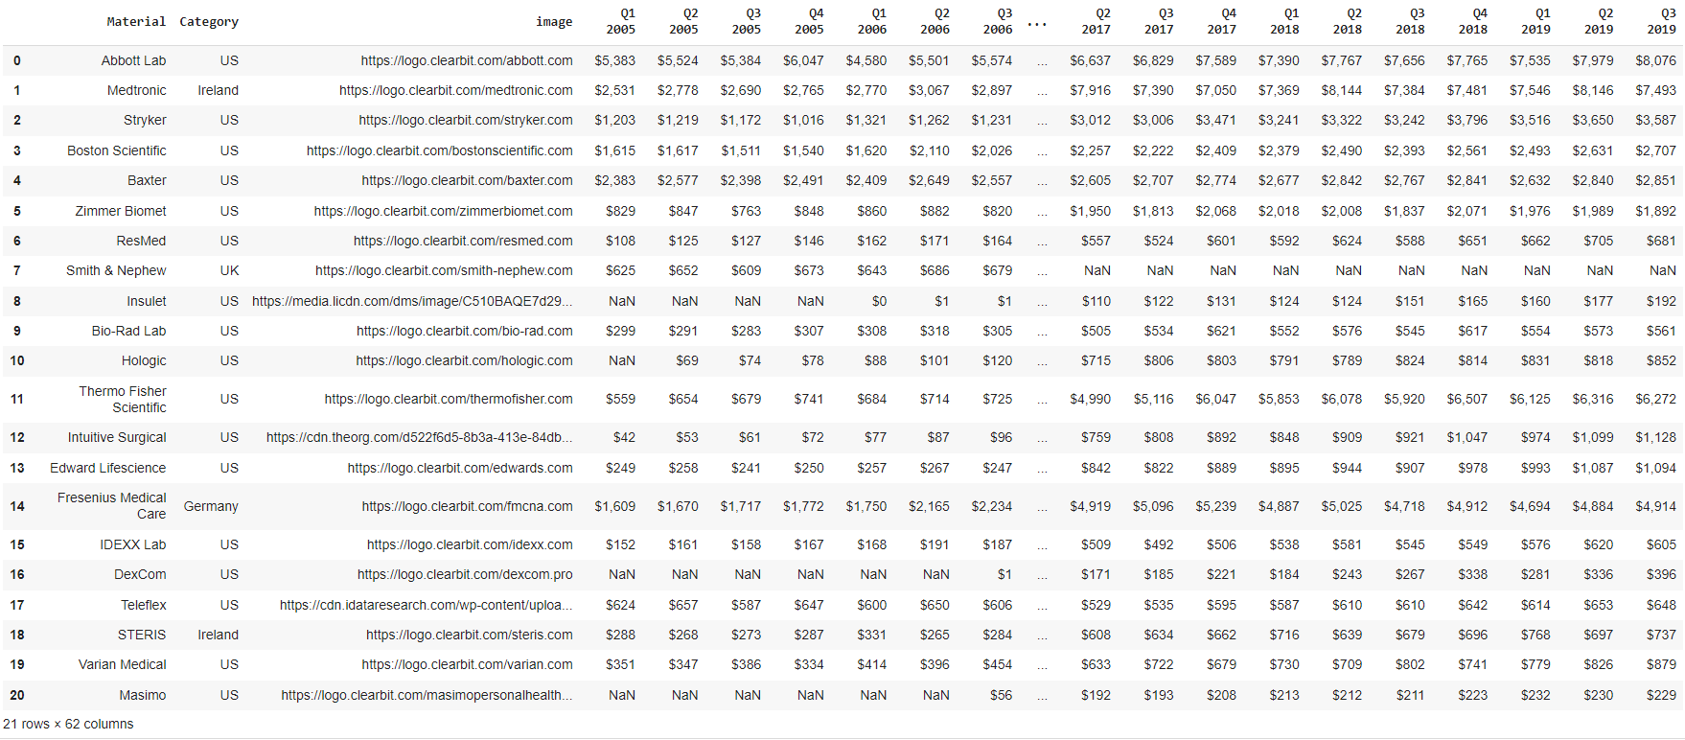
The Dataset

Slide 7
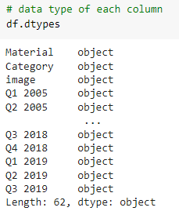
The Datatype of each column

Slide 8
03
Preprocessing & Visualization

Slide 9
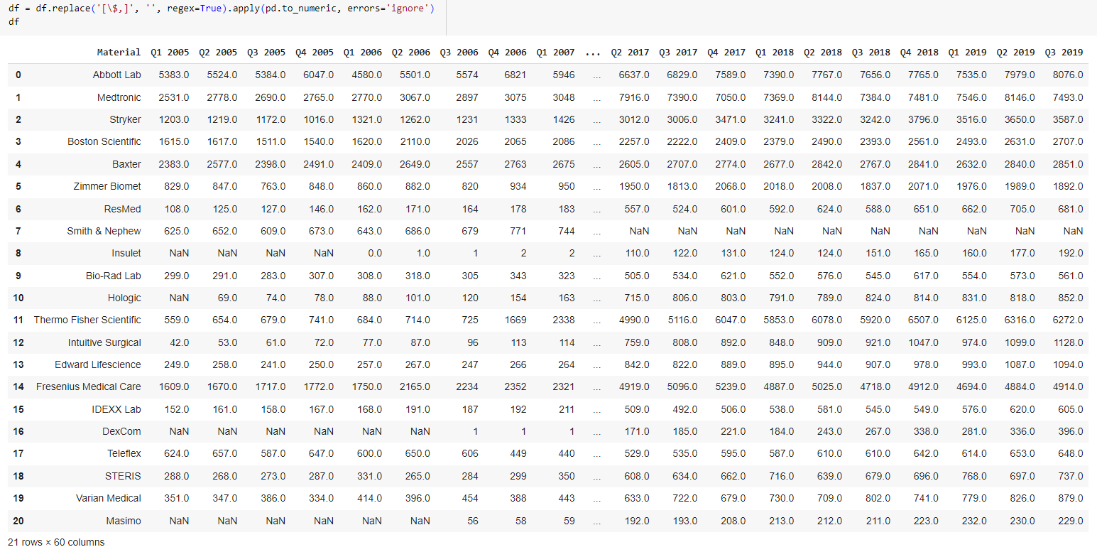
Data Conversion
Converted revenue data from string format to numeric format by removing '$' and ',' characters.

Slide 10
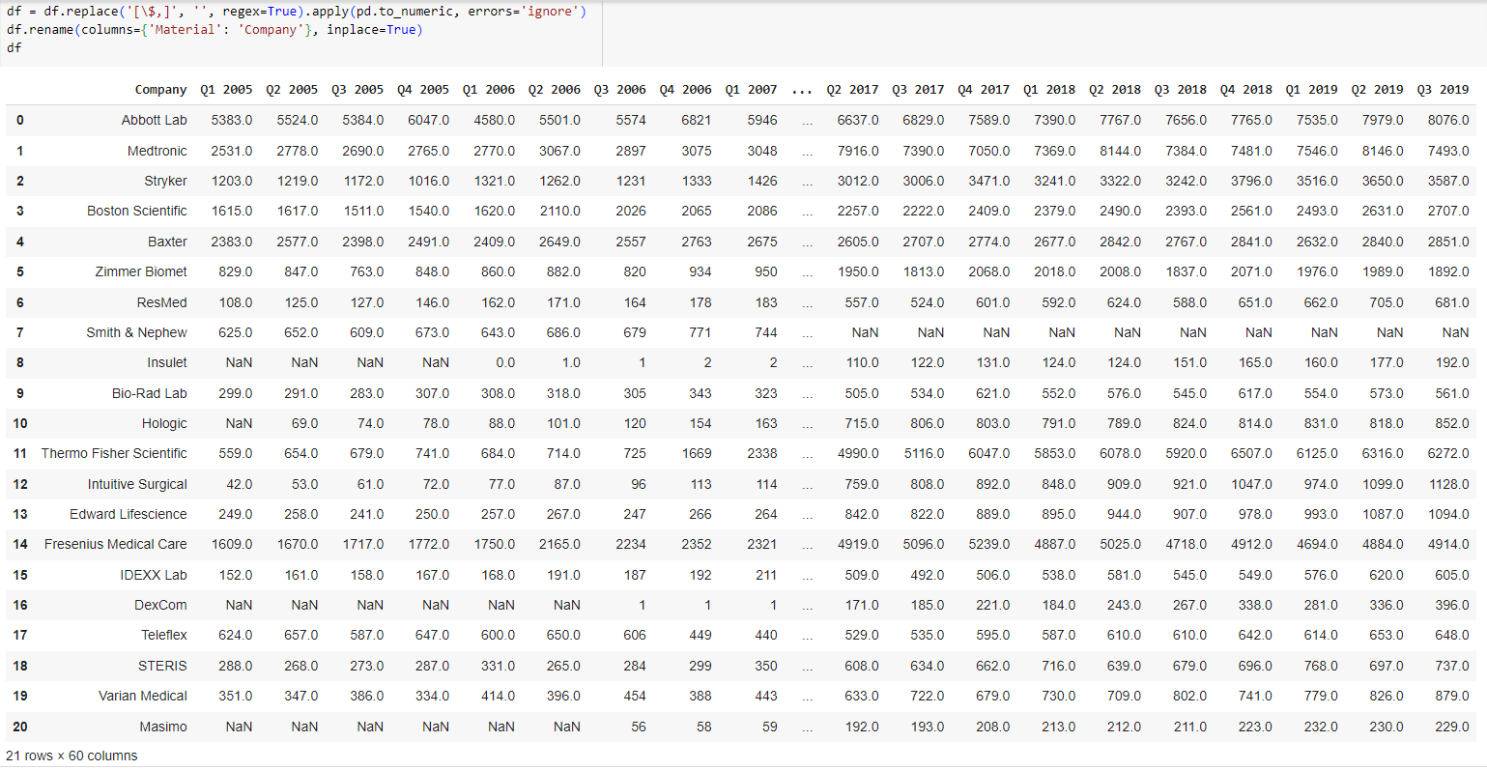
Data Cleaning
Removed unnecessary columns ('Category', 'image') that were not relevant for the analysis and renaming the material column to be more understandable
.

Slide 11
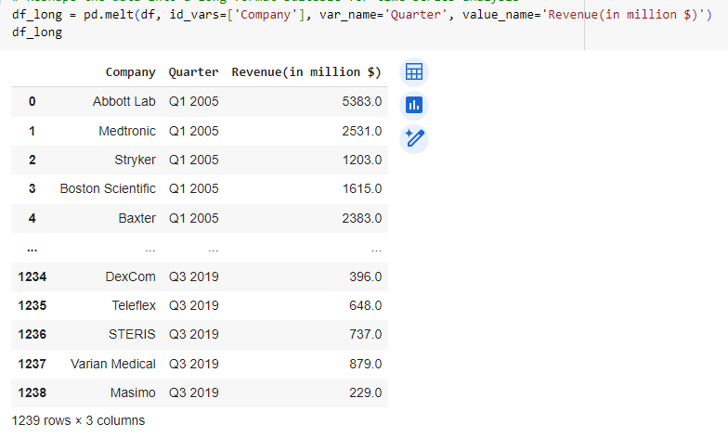
Data Reshaping
Transformed the dataset from wide format to long format to facilitate time series analysis.

Slide 12
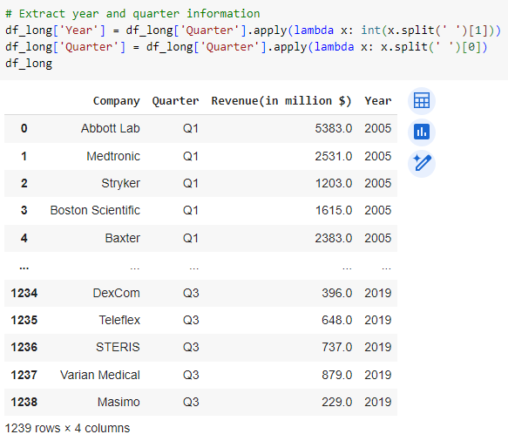
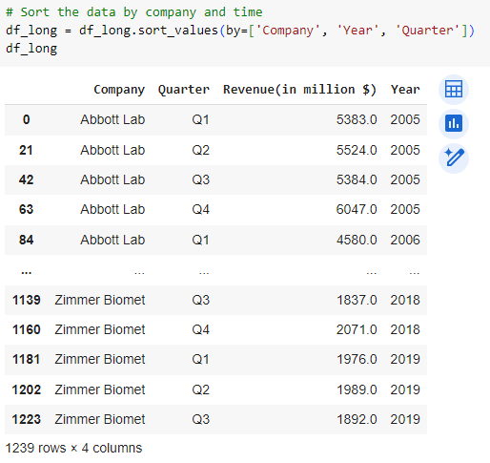
Date Creation
Created a 'Date' column by mapping quarters to the corresponding months and combining with the year.

Slide 13
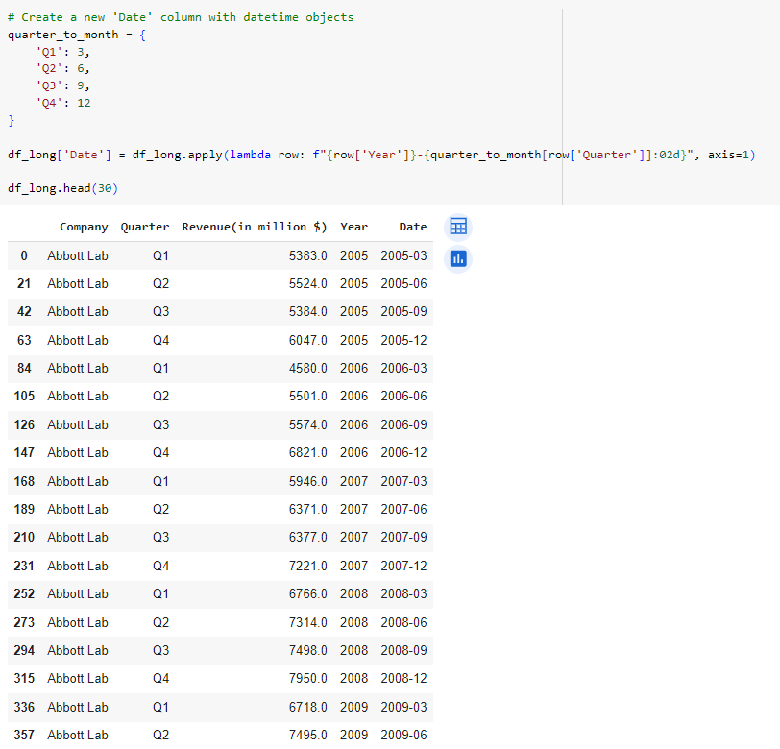
Date Creation
Created a 'Date' column by mapping quarters to the corresponding months and combining with the year.

Slide 14
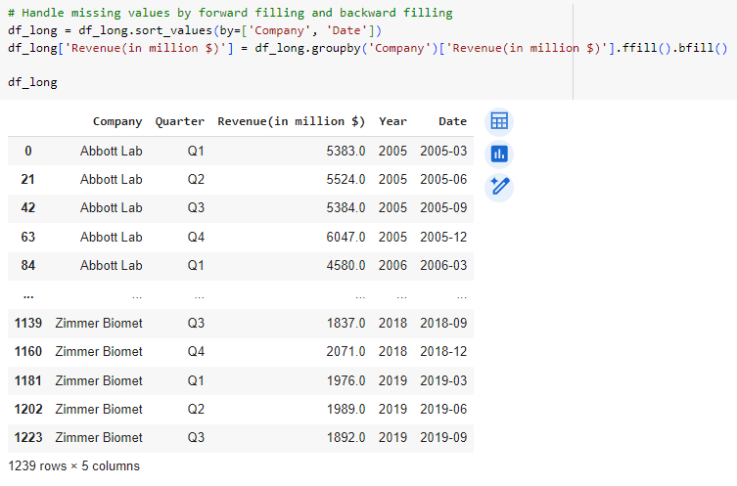
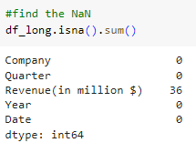
Handling Missing Values
Addressed missing values by forward and backward filling within each company.

Slide 15
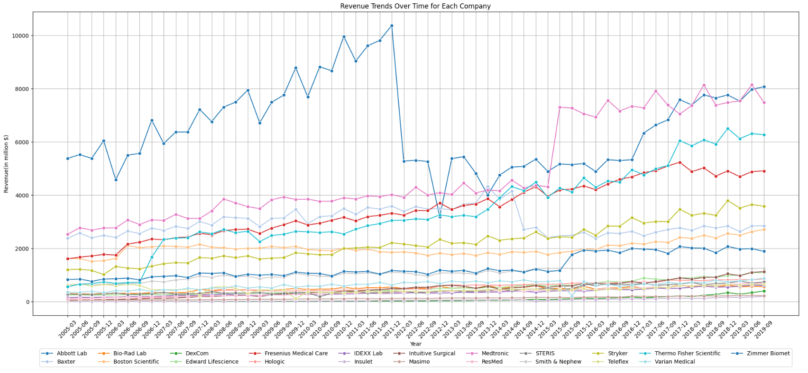
Visualization

Slide 16
04
Model Training and Testing

Slide 17
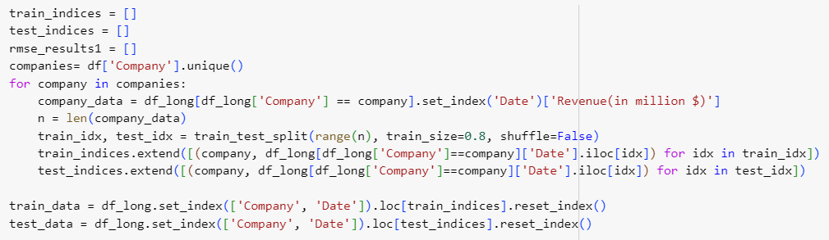
Splitting the data into training dataset and testing dataset

Slide 18
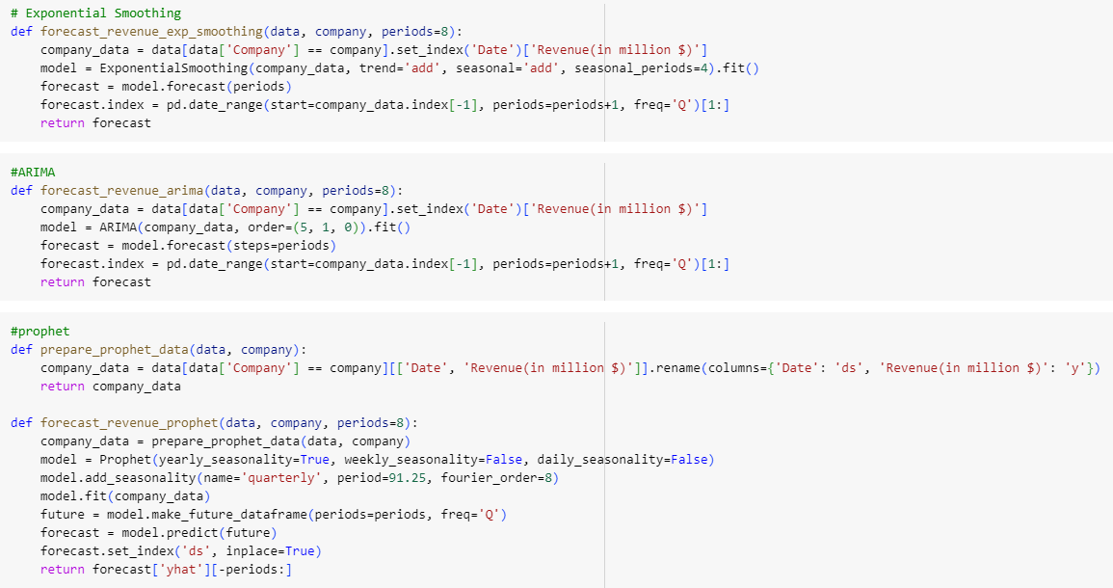
Exponential smoothing , ARIMA and Prophet models

Slide 19
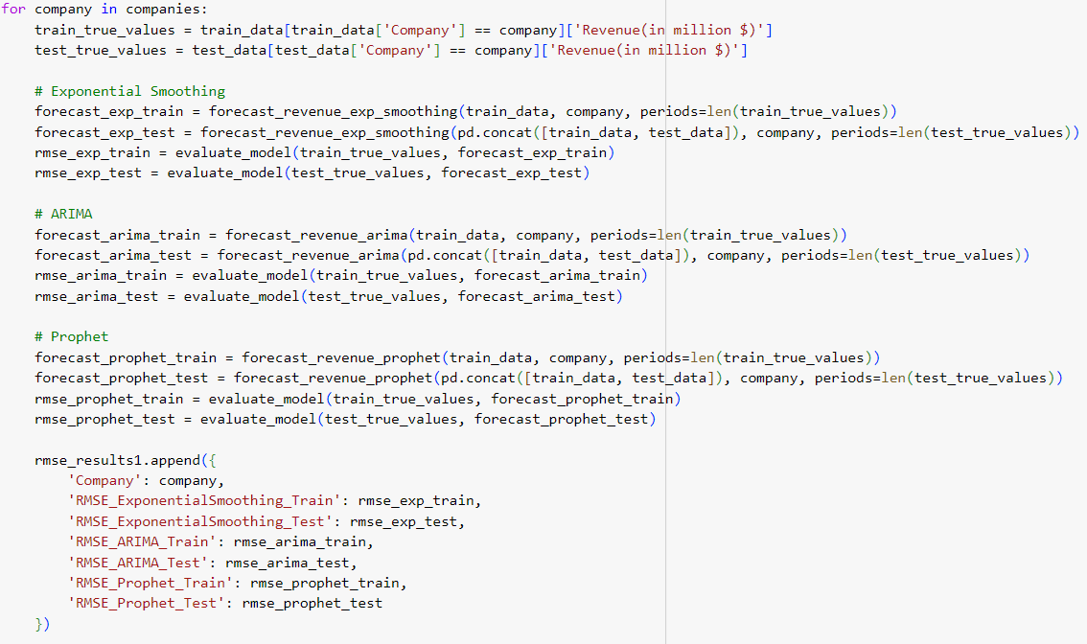
Model fitting

Slide 20
05
Comparison between models and model selection

Slide 21
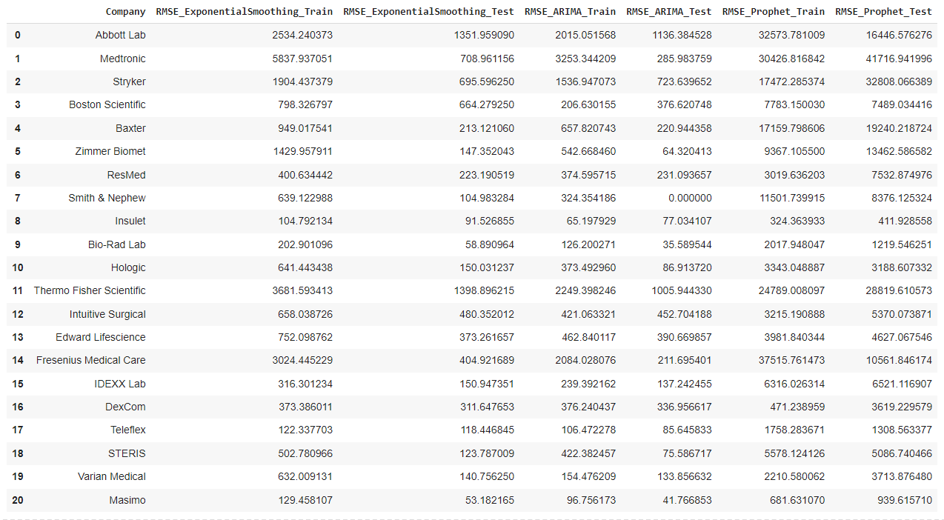
Comparison using RMSE

Slide 22
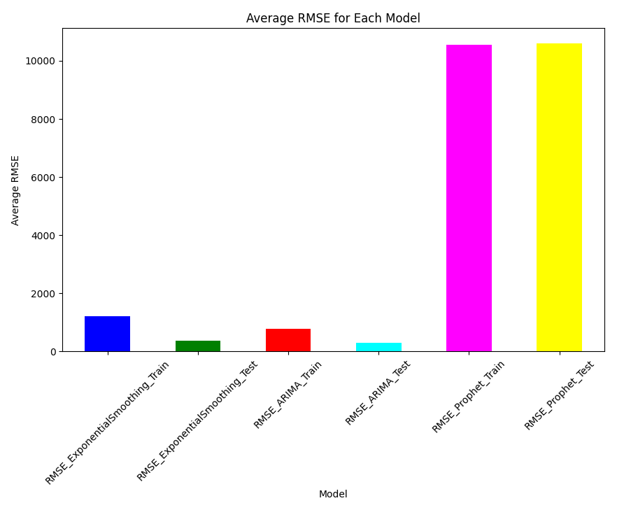
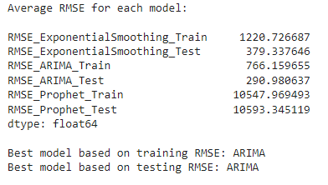
Model Selection

Slide 23
06
Forecasting

Slide 24
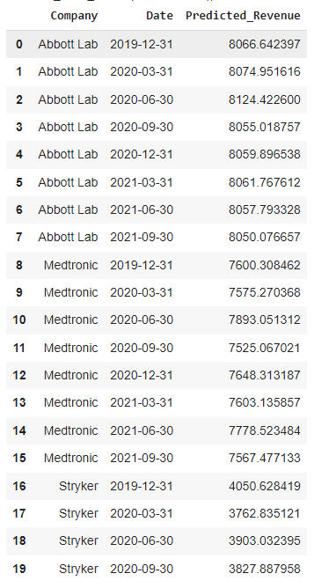
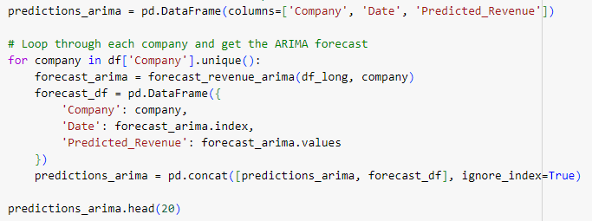
Predictions using ARIMA model

Slide 25
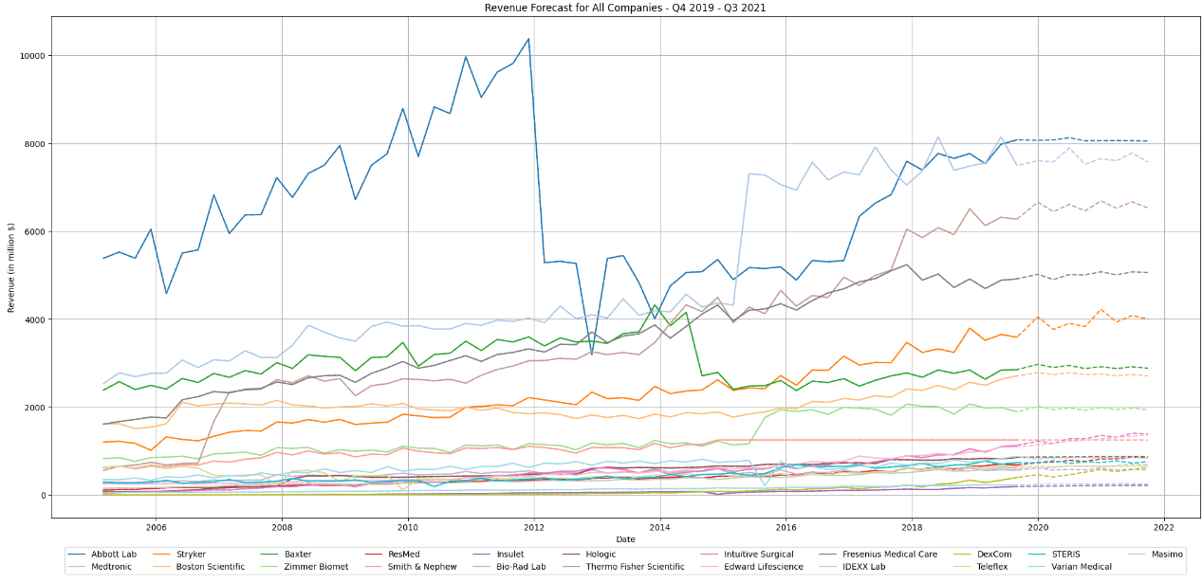
Forecasting Visualization

Slide 26
Thank you!

